Slide 1
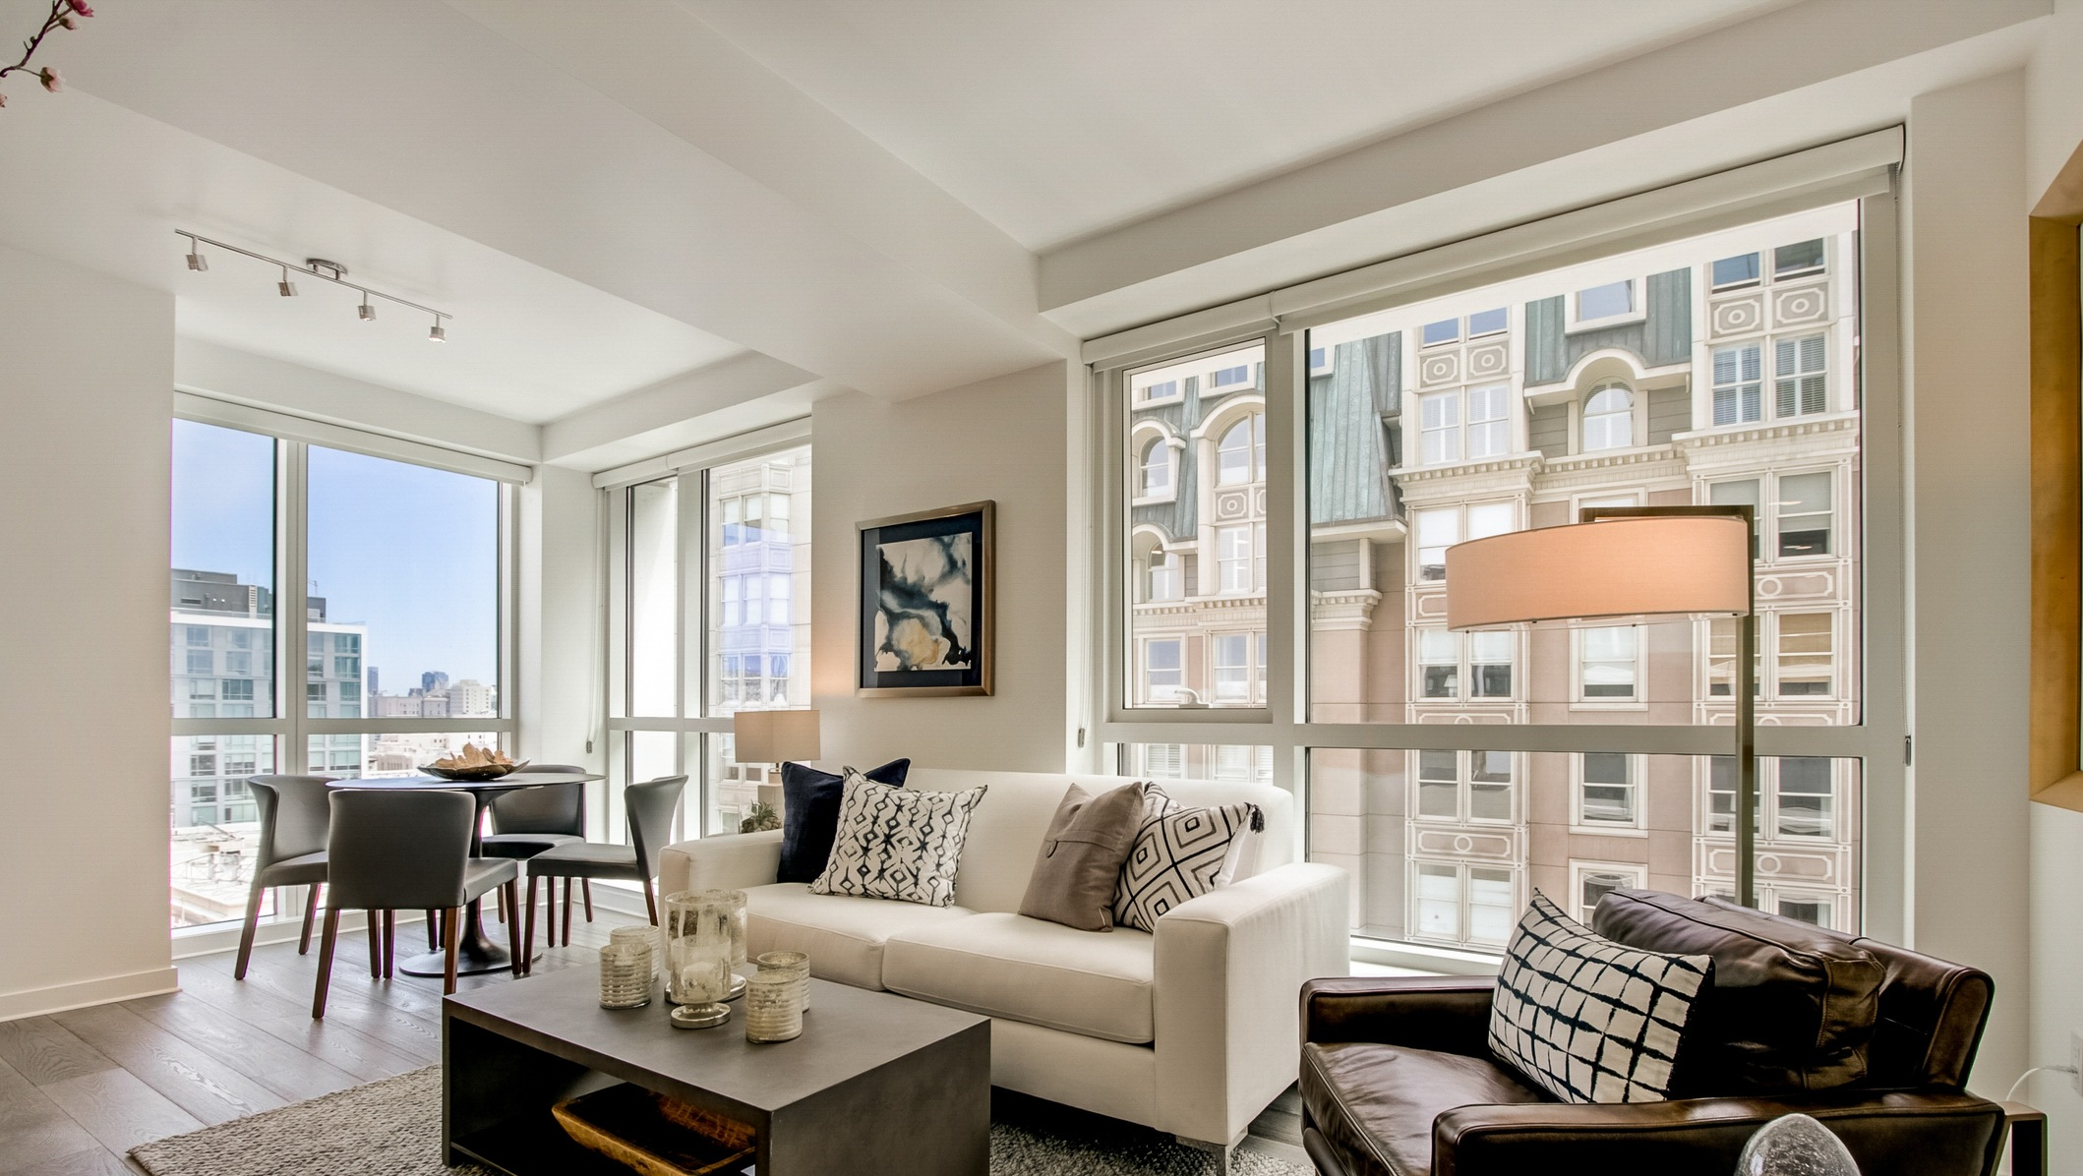
Cost of a Home in San Francisco
Sara Zong
Jan 22nd, 2021

Slide 2
Motivation:
San Francisco has attracted talents all over the United States. Some may come and go, but there are many that love the city enough to consider buying a house and staying long-term.
Is this a good time to buy a house?
What type of property could we afford?
Which neighborhood is the most affordable?
What price should we offer?
Notes:
High paid jobs, great food, fun activities, just to name a few reasons, San Francisco has attracted talents all over the country. Some people may come and go, but there are many who love the city enough to consider buying a house and staying long-term. For people who are thinking about that, they may want to know is this a good time to buy a house? What type of property could we afford? Which neighborhood is the most affordable in the city? What price should we offer if we find a property we like? With all the freely available property listings online from different websites like Redfin and Zillow, I think I could make use of them to build a house price predictor to provide consultation services to house searchers.

Slide 3
Motivation:
San Francisco has attracted talents all over the United States. Some may come and go, but there are many that love the city enough to consider buying a house and staying long-term.
Is this a good time to buy a house?
What type of property could we afford?
Which neighborhood is the most affordable?
What price should we offer?
Notes:
High paid jobs, great food, fun activities, just to name a few reasons, San Francisco has attracted talents all over the country. Some people may come and go, but there are many who love the city enough to consider buying a house and staying long-term. For people who are thinking about that, they may want to know is this a good time to buy a house? What type of property could we afford? Which neighborhood is the most affordable in the city? What price should we offer if we find a property we like? With all the freely available property listings online from different websites like Redfin and Zillow, I think I could make use of them to build a house price predictor to provide consultation services to house searchers.

Slide 4





Method:
Notes:
I used Selenium to drive google chrome, to navigate through pages on Redfin for property listings in the past year. Then I built a LASSO regression model with scikit learn to predict house price.

Slide 5
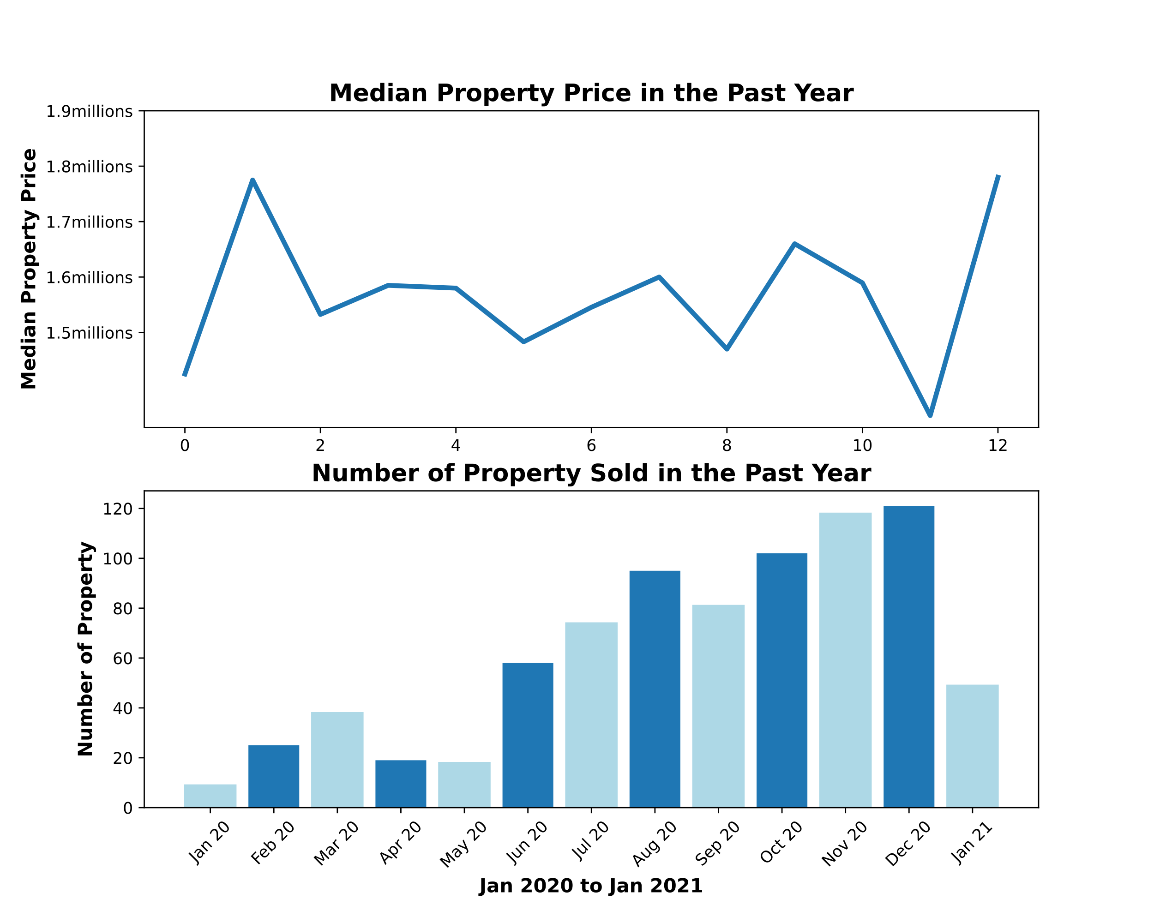
Price stabilized in the past year
Notes:
Here are what I found: first of all, the median price for properties in the past year seemed to be stabilized if not decreased. To provide some context, property price had increased continuously from 2012 to 2019 for 126%. The supply of property in the market increased. If anyone is thinking about buying, now it’s time to start looking.

Slide 6
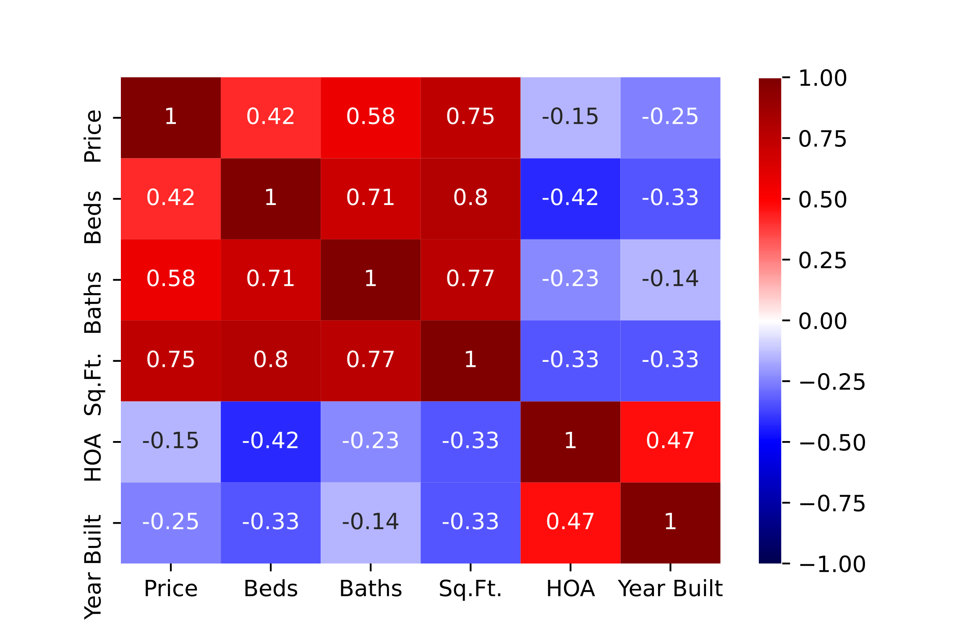
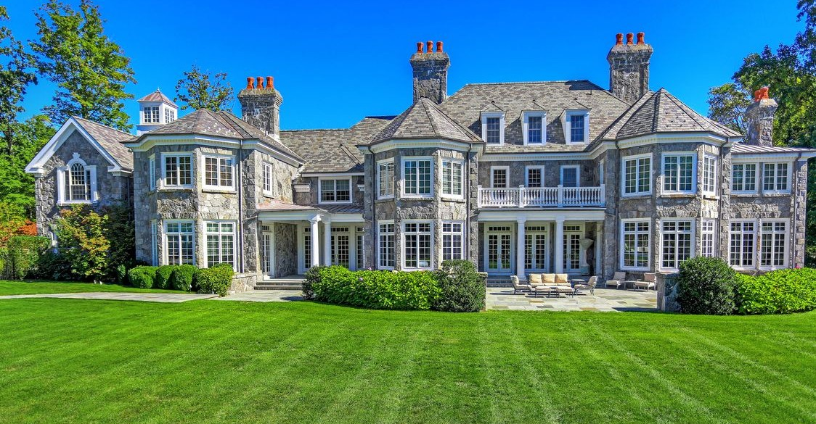
Size of a property really matters
Notes:
A few other findings: size of a property predicts the price most. As you can see from this heat map, which plots the correlations between property price and a few factors. Size is the most highly correlated factor to price.

Slide 7
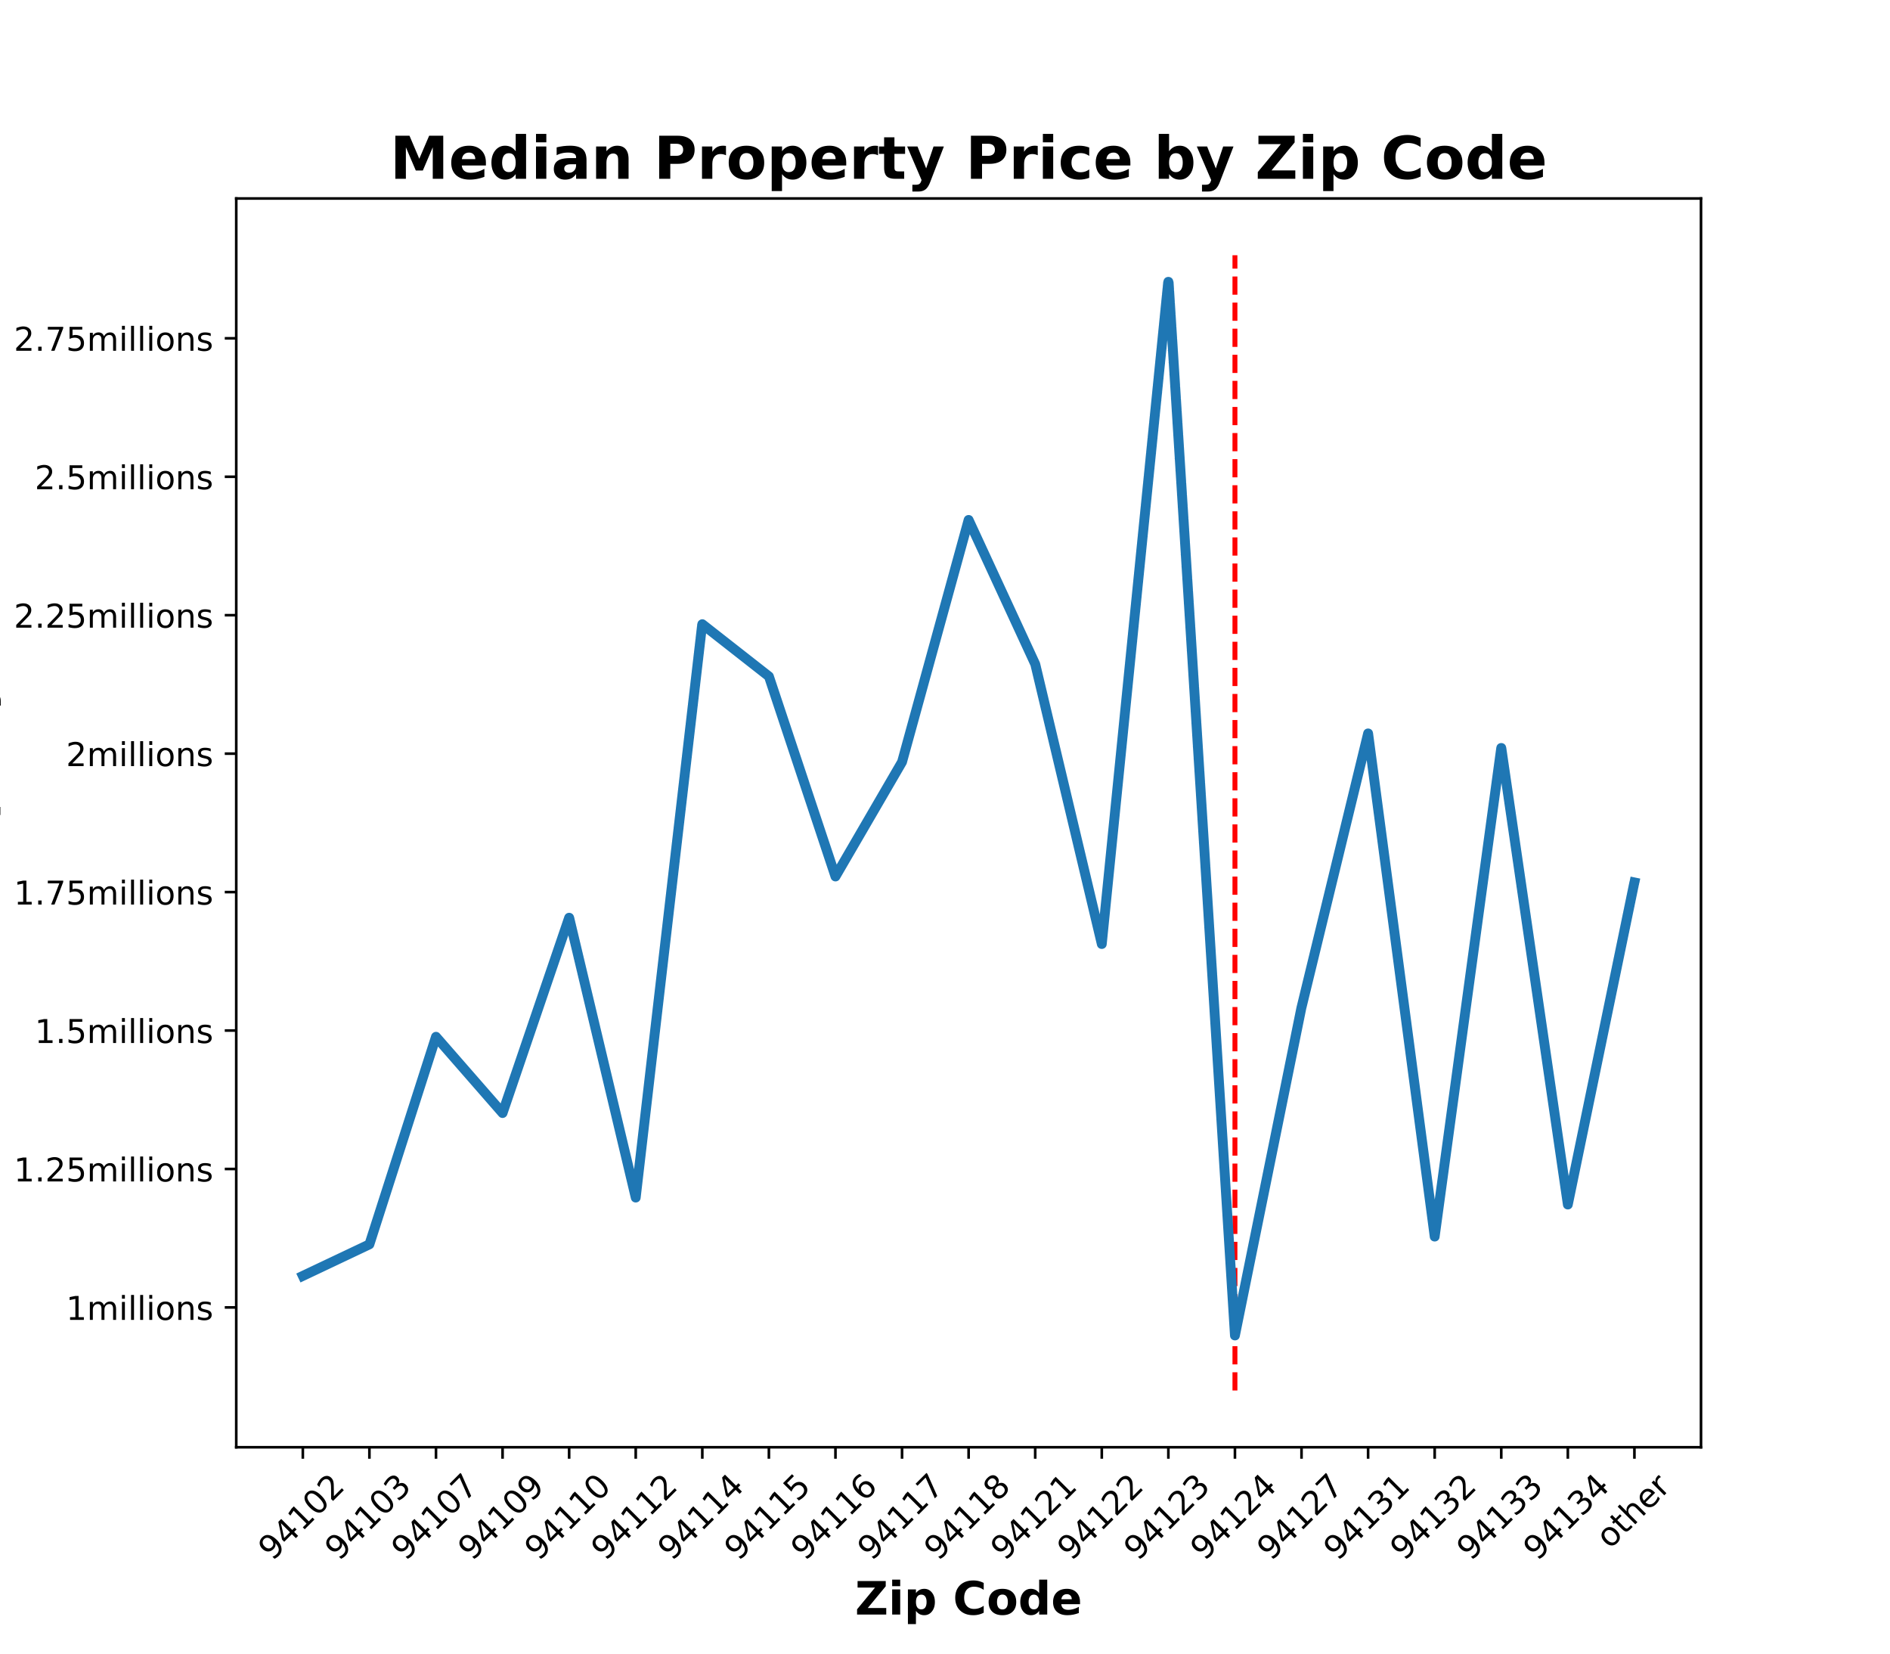
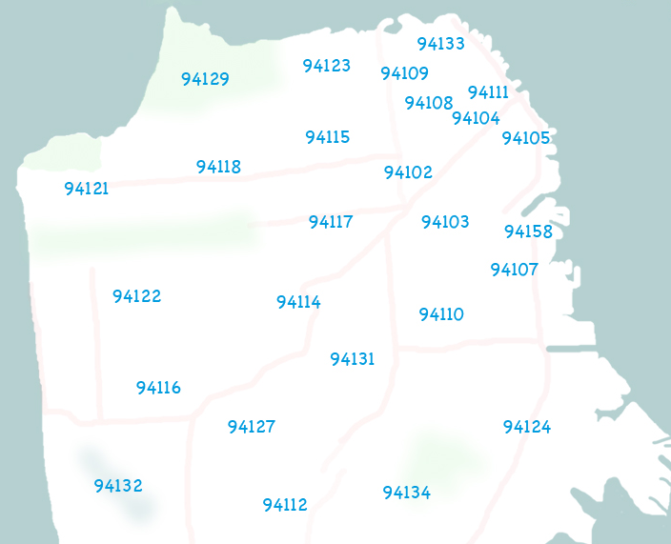
Some areas are more affordable than the others
949k
Notes:
Some areas in the city are more affordable than the others. I in my model, I find Bay View neighborhood, which locates in the south east side of the city, is one of the most affordable areas, with a median property price at 949k.

Slide 8
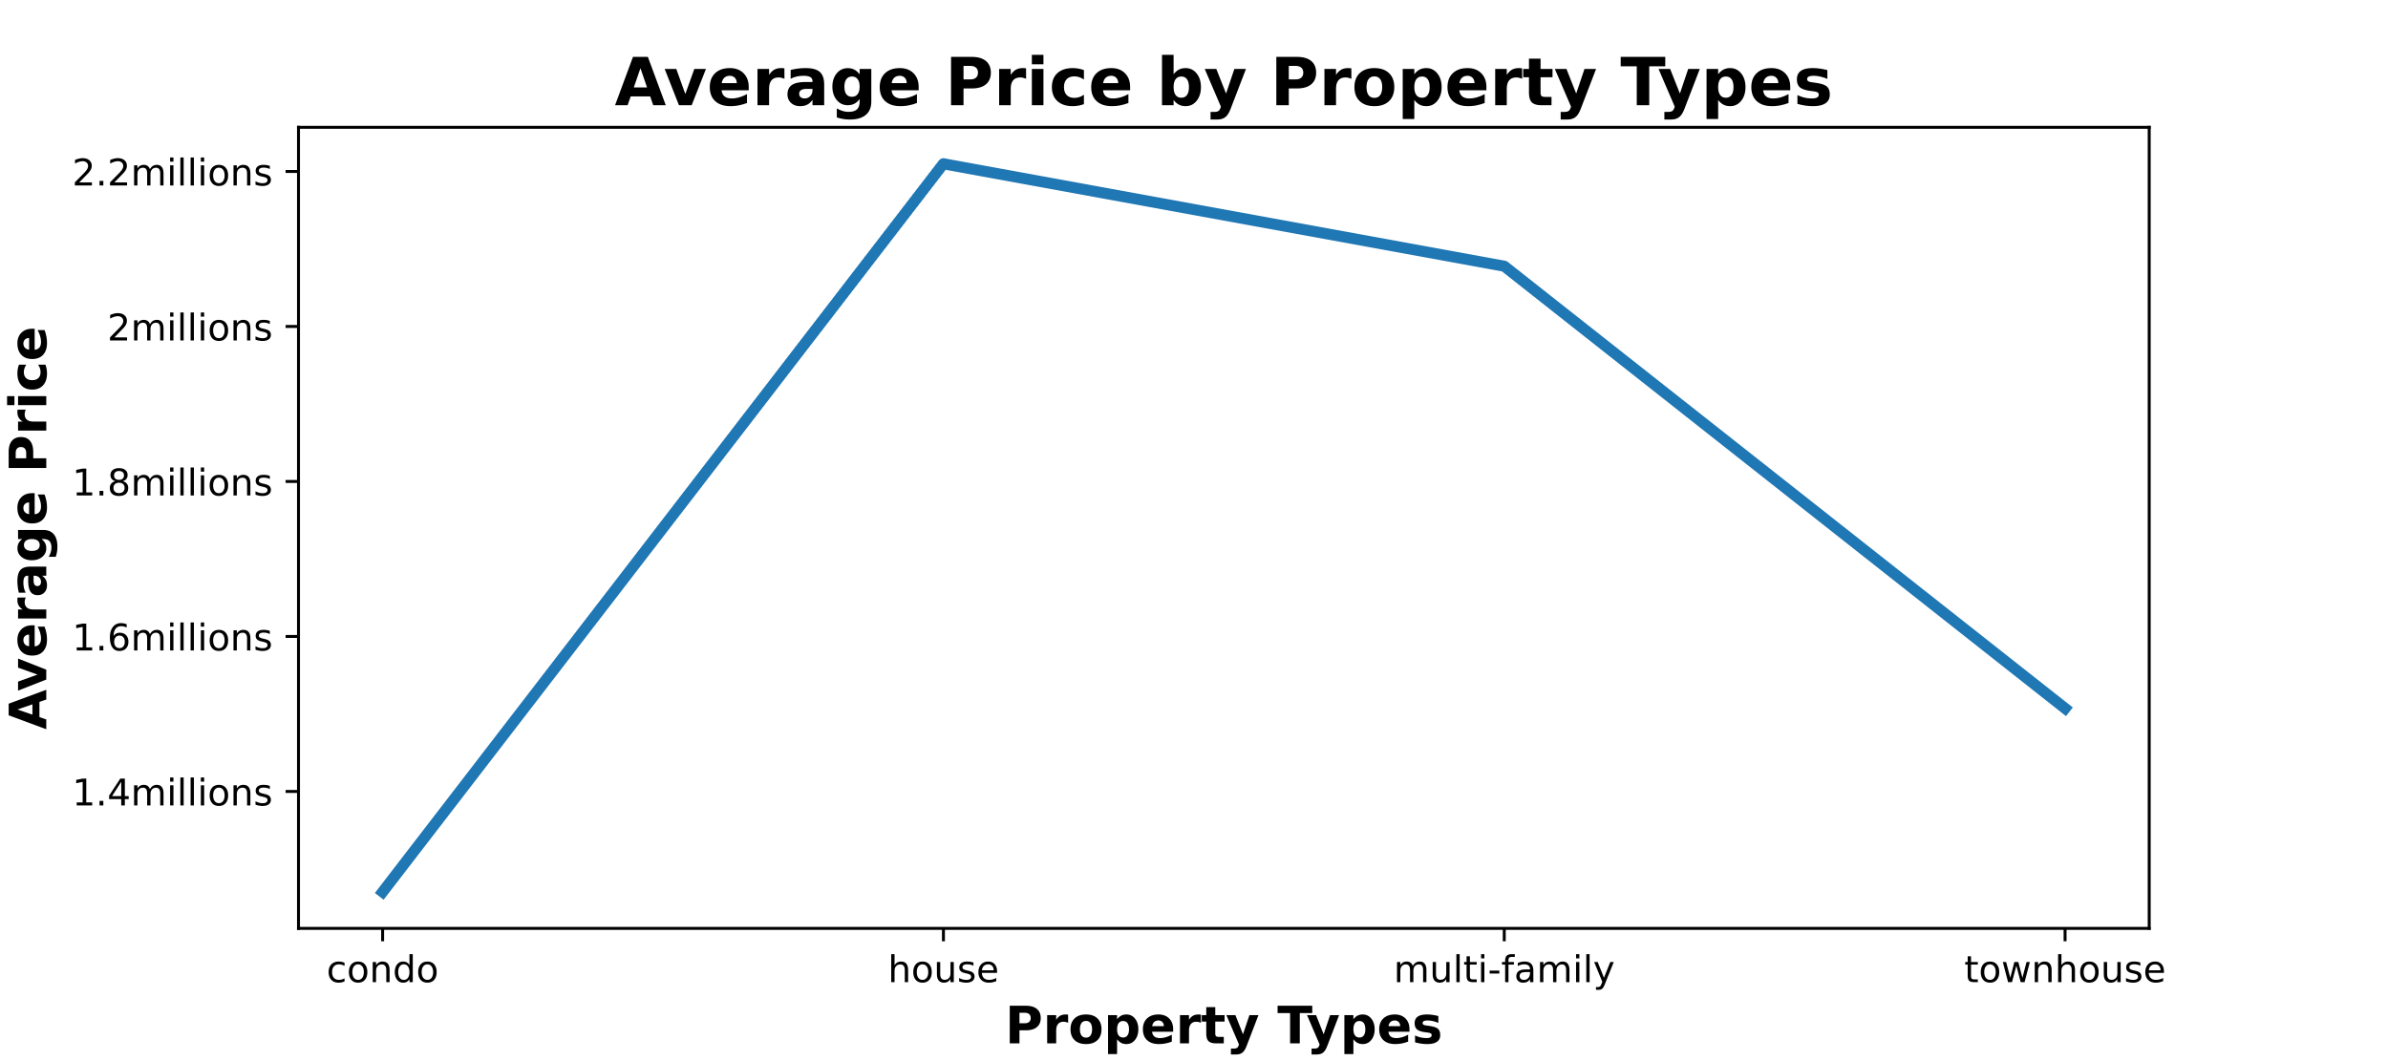
Condo is the most affordable option
Notes:
Among different property types, condo is the most affordable option with average price at 1.2mil and house is the most expensive.

Slide 9




Condo is the most affordable option
House
Townhouse
Condo
Multi-fam
Notes:
After adjusting for other factors in the model, from the most expensive to the least expensive options, it’s house, followed by townhouse, condo, and multi family units.

Slide 10
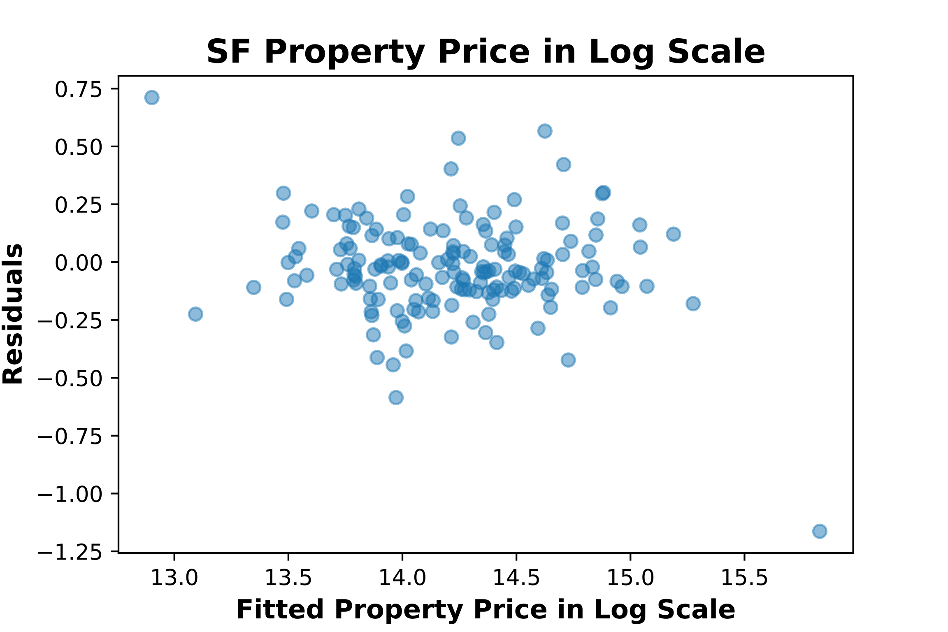
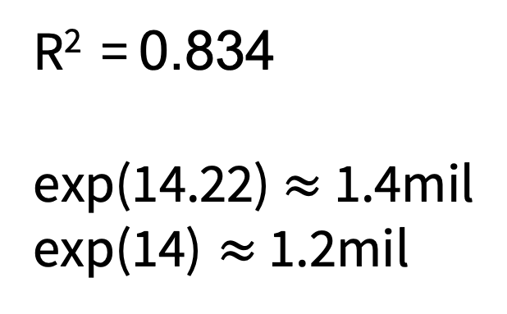
LASSO model seems to work okay across price range
R² = 0.834
exp(14.22)$≈$ 1.4mil
$\text{exp}\text{(14)}≈$ 1.2mil
440k
5.4mil
Notes:
My model seems to work okay across price range as shown by the randomly scattered residuals. On the x-ais is the property price in log scale and on the y-axis, it’s the difference between predicted values and actual values in log scale. However, the price prediction with R square at 0.834 is not very accurate. To provide some context, a house costs 1.4 million, when it’s 0.22 off, it becomes 1.2 million, 200k difference.

Slide 11
Conclusion:
Now is a good time to start looking (stabilized price and historical low interest rate!)
The type of property and location to consider depends on the budget and other factors, but most affordable: condo, Bay View neighborhood
Unfortunately, price prediction is not very accurate (more listings, more features)

Slide 12
Conclusion:
Now is a good time to start looking (stabilized price and historical low interest rate!)
The type of property and location to consider depends on the budget and other factors, but most affordable: condo, Bay View neighborhood
Unfortunately, price prediction is not very accurate (more listings, more features)

Slide 13
Conclusions:
Now is a good time to start looking (stabilized price and historical low interest rate!)
The type of property and location to consider depends on the budget and other factors, but most affordable: condo, Bay View neighborhood
Unfortunately, price prediction is not very accurate (more listings, more features)

Slide 14
Thanks!
Any questions?

Slide 15
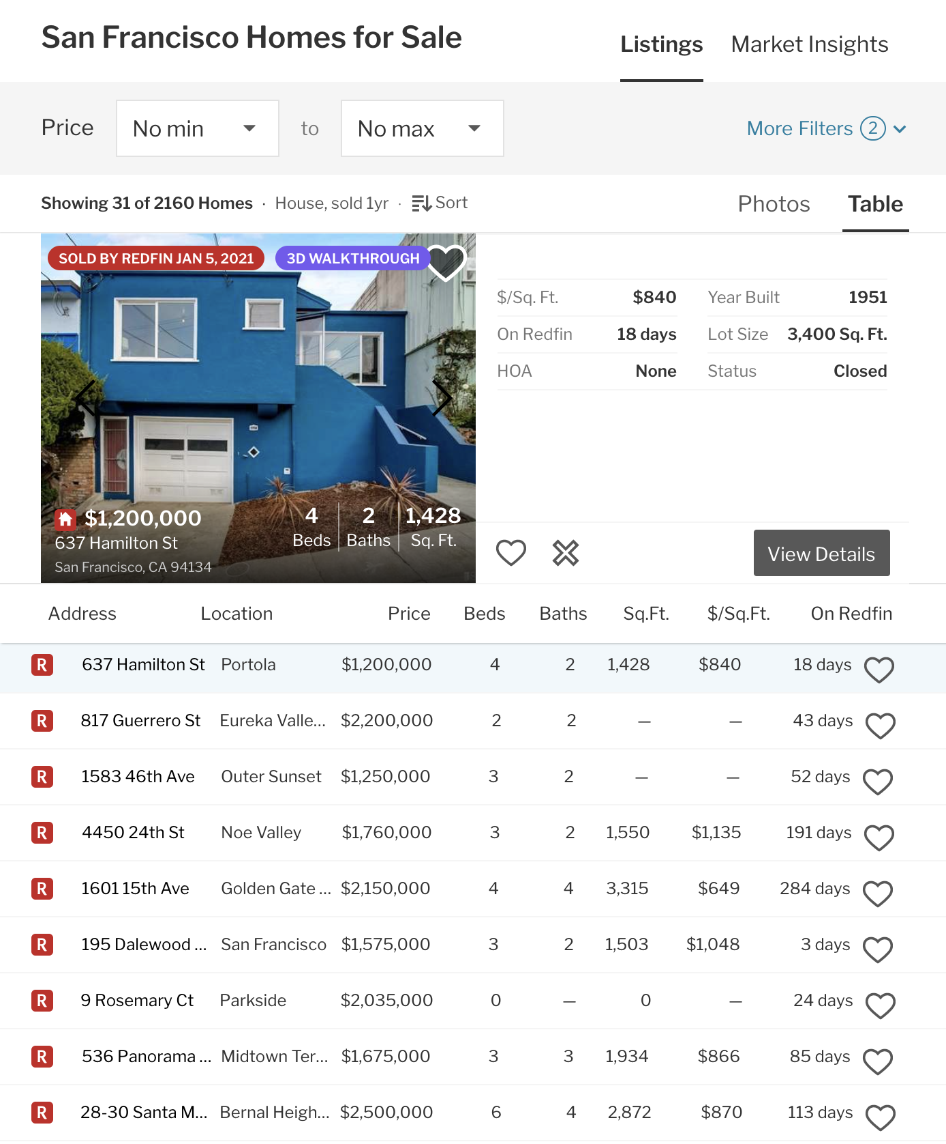
Appendix:
Features for 806 listings:
Beds
Baths
Size(Sq.Ft.)
HOA
Year Built
Property Type(4 categories)
Zip Codes(21 categories)
v
v

Slide 16
Appendix: Coefficient from LASSO
Features Table 1: | Coef:
House (Prop Type) | 0.117
Multi-fam (Prop Type) | -0.029
Townhouse (Prop Type) | 0.019
Beds | -0.017
Baths | 0.046
HOA | 0.041
Log Sq.Ft. | 0.36
Property Age | 0.017
Features Table2: | Coef:
94112 (zip code) | -0.073
94124 (zip code) | -0.072
94132 (zip code) | -0.042
94134 (zip code) | -0.038
94121 (zip code) | -0.014
94122 (zip code) | -0.014
94116 (zip code) | -0.012
94103 (zip code) | -0.0093
94127 (zip code) | -0.0088
94109 (zip code) | ---
Features Table2: | Coef:
94110 (zip code) | ---
94131 (zip code) | ---
94107 (zip code) | 0.0028
94133 (zip code) | 0.016
94118 (zip code) | 0.021
94117 (zip code) | 0.023
94114 (zip code) | 0.028
94115 (zip code) | 0.029
94123 (zip code) | 0.047
other (zip codes) | 0.017

Slide 17
Credits:
www.redfin.com
www.slidescarnival.com
https://en.wikipedia.org/wiki/Scikit-learn
https://medium.com/cs-note/web-crawling-by-using-selenium-python-3-4fff0bdb4c65
https://missionlocal.org/san-francisco-restaurant-health-inspections/
https://therealdeal.com/tristate/2020/04/01/greenwich-mansion-with-loads-of-privacy-seeks-10m/

